Slide 1
Discussion 5
Abstract Data Types

Slide 2
Administrivia
Attendance to lab this week is highly recommended, will be a ramp up for project 2
Project 2 will be released Wednesday!
You may schedule one-on-ones with a TA after midterm 1 (more details will be announced on Piazza)

Slide 3
List
An ordered collection or sequence
add(element); // adds element to the end of the list
add(index, element); // adds element at the given index
get(index); // returns element at the given index
size(); // the number of elements in the list
Notes:
With abstract data structures it’s important to focus on the fact that the implementation of these methods doesn’t matter. It’s what it does rather than how it does it that is important.
Deques are a great example of this. In proj1b it didn’t matter whether you used your LinkedListDeque implementation or your ArrayDeque implementation, all that mattered was that the API was met.
Can think of the high level descriptions of each ADT on the worksheet as a rough interface or abstract class.
Remind students to treat these like a black box
Java implementations of this include LinkedList and ArrayList

Slide 4
Set
A (usually unordered) collection of unique elements
Calling add(“hi”) twice doesn’t change anything about the set
add(element); // adds element to the collection
contains(object); // checks if set contains object
size(); // number of elements in the set
remove(object); // removes specified object from set

Slide 5
Map
A collection of key-value mappings
The keys of a map are unique
Analogous to a dictionary in python
put(key, value); // adds key-value pair to the map
get(key); // returns value for the corresponding key
containsKey(key); // checks if map contains the specified key
keySet(); // returns set of all keys in map

Slide 6
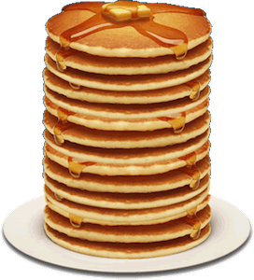
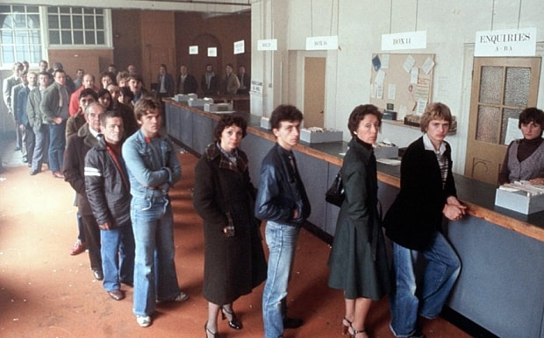
Stacks and Queues and Deques
Linear collections with rules about item addition/removal
Stacks are Last In First Out (LIFO)
Queues are First In First Out (FIFO)
Deques combine both
Notes:
These names are actually very intuitive!
When waiting in queues at starbucks or the DMV, it’s first come first serve
Serving a stack of pancakes one by one? You’d probably take the top one off first
Where else are stacks? Recursion OooOooOoOo
Double Ended Queues allow for insertion/removal off either side at your own discretion
http://i.telegraph.co.uk/multimedia/archive/03434/queue_3434246b.jpg
http://frugalfinders.com/wp-content/uploads/2013/02/Stack-of-Pancakes.png

Slide 7
Priority Queue
Like a queue but each element has a priority associated with it that determines the ordering of removal
add(e); // adds element e to the priority queue
peek(); // looks at the highest priority element, but does not remove it from the PQ
poll(); // pops the highest priority element from the PQ
Notes:
An example may be helpful here since most haven’t encountered priority queues before
Inserting a roster of athletes into a priority queue ordered by height: tallest first
Inserting students into a queue with the priority being their name: alphabetical order popping
Priority queues in Java use comparators to order

Slide 8
Solving problems with ADTs
Don’t worry about implementation, assume the ADTs correctly implement their given set of methods
Writing pseudocode might help you
It also might not, depends on you
Try out a few of the ADTs and compare their usefulness in the situation
Think about correctness first, and then efficiency
Notes:
There’s not necessarily one right answer with these. This is to get students familiar with using ADTs and to practice thinking about solving problems in this way. Don’t shoot down ideas too fast

Slide 9
(a) Given a news article, find the frequency of each word used in the article.
Use a map. When you encounter a word for the first time, put the key into the map with a value of 1. For every subsequent time you encounter a word, get the value, and put the key back into the map with its value you just got, plus 1.

Slide 10
(b) Given an unsorted array of integers, return the array sorted from least to greatest.
Use a priority queue. For each integer in the unsorted array, enqueue the integer with a priority equal to its value. Calling dequeue will return the largest integer; therefore, we can insert these values from index length-1 to 0 into our array to sort from least to greatest.

Slide 11
(c) Implement the forward and back buttons for a web browser
Use two stacks, one for each button. Each time you visit a new web page, add the previous page to the back button’s stack. When you click the back button, add the current page to the forward button stack, and pop a page from the back button stack. When you click the forward button, add the current page to the back button stack, and pop a page from the forward button stack. Finally, when you visit a new page, clear the forward button stack.

Slide 12
BiDividerMap
put(k, V); // put a key, value pair
getByKey(K); // get the value corresponding to a key
getByValue(V); // get the key corresponding to a value
numLessThan(K); // return number of keys in map less than K

Slide 13
BiDividerMap
Create two maps, Map<K, V> and Map<V, K>.
How does this change insertion into the data structure compared to a normal map?
numLessThan?
Get the list of keys (remember keySet?), sort it (N log N) and iterate or binary search
Or keep a sorted list of keys in addition to the two maps, keeping it ordered as insertions occur
Notes:
Running through a small example with pseudocode and this design will help
example - put(k, v) :
mapKToV.put(k, v)
mapVToK.put(v, k)

Slide 14
MedianFinder
add(x); // adds x to the collection of numbers
median(); // returns the median from a collection of numbers

Slide 15
MedianFinder
Use a list to store numbers, then sort it and return the middle index element when median() is called
Two priority queues: lessThanMedian (max PQ) and greaterThanMedian (minPQ)
Always keep track of the current median and store the rest of the numbers in the appropriate priority queue
Rebalance as necessary when adding. i.e. if you lessThanMedian has size 4 and greaterThanMedian has size 5 and you the number you’re adding will go in greaterThanMedian, move the current median to lessThanMedian and the min of greaterThanMedian becomes your new median.
Notes:
Again, an example walked through on the board would be great here, especially for the two priority queues solution

Slide 16
Define a Queue using Stacks
Brainstorm first before writing any code
Check your work with a small example

Slide 17
public class Queue {
private Stack stack = new Stack();
public void push(E element) {
Stack temp = new Stack();
while (!stack.isEmpty()) {
temp.push(stack.poll());
}
stack.push(element);
while (!temp.isEmpty()) {
stack.push(temp.poll());
}
}
public E poll() {return stack.poll(); }
}
Notes:
The two stacks approach: The main stack contains the numbers such that the top of the stack is actually the FIRST in :O
We’re basically trying to add to the bottom of the stack.
Imagine having to move all the pancakes in your stack one by one to another plate before placing the new pancake on the bottom and then moving the other plates pancakes back on to the original plate, on top of the newly added pancake.
Every time you push an element, push every element in the main stack into a temporary stack (notice that the temporary stack is now in reverse order of the original). Then, push the new element onto the main stack and push everything from the temp stack to the main one.
This ensures that the last (most recent) item to be added is the
It’d be cool if you took out some books and acted this out in literal stacks.

Slide 18
public class Queue {
private Stack stack = new Stack();
public void push(E element) { stack.push(element); }
public E poll() { return poll(stack.pop()); }
private E poll(E previous) {
if (stack.isEmpty()) {
return previous;
}
E current = stack.poll();
E toReturn = poll(current);
push(previous);
return toReturn;
}
}
Notes:
This is basically the same as the two stacks approach but we use the call stack with recursion :O ooOOoOoOOOoo

